Slide 1

Presentation on E-Commerce (all in one)
Presentation on E-Commerce (all in one)
Team Members:-
Supreet Suman (18CSE126)
Shahid Akhtar (18CSE194)
Rohan Das (18CSE127)

Slide 2
introduction
E-commerce definition
About our system

Slide 3
What is E-Commerce
It is commonly known as electronic marketing.
It consist of buying and selling goods and services over an electronic system such as the internet.
E-commerce is the purchasing , selling & exchanging goods and services over computer network or internet through which transactions or terms of sale are performed electronically.

Slide 4
Our system
Our System is an e-commerce website from where people can buy products online.
Admin monitors the cart items and product stocks as per the customer needs.
Admin update the transaction pages, and other refund initiatives.
Our system is fully responsive and it's having a multiple feature of accessible

Slide 5
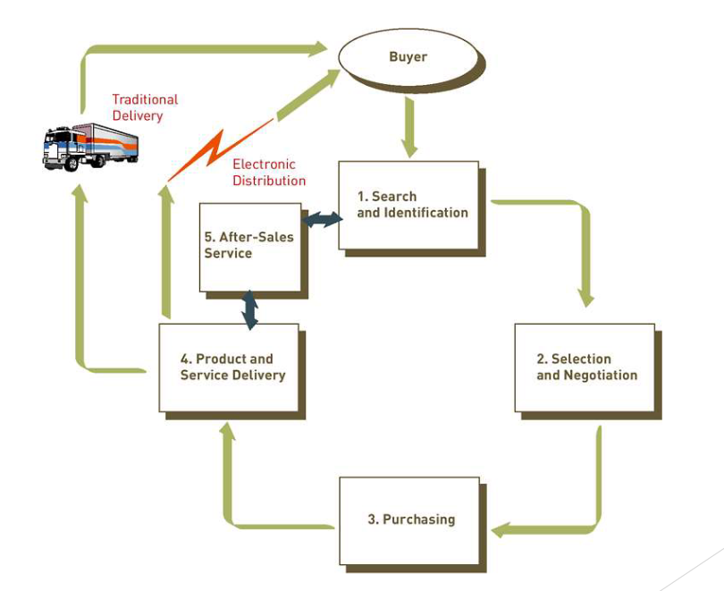
THE PROCESS OF E-COMMERCE

Slide 6
Features:-
Log in
Menu
Catalog Browsing
Category List
Product List
Catalog Management
Product Browsing
Product Reviews
Related Products
Shopping Cart
Checkout
Auto generated bill
Conformation through Gmail
Payment Gateway
cash on delivery
smart card were also accepted

Slide 7








Languages:-
HTML 5
CSS 3
Bootstrap
Python
Tools:-
Adobe Photoshop
Pycham
Sqllite3
Django

Slide 8
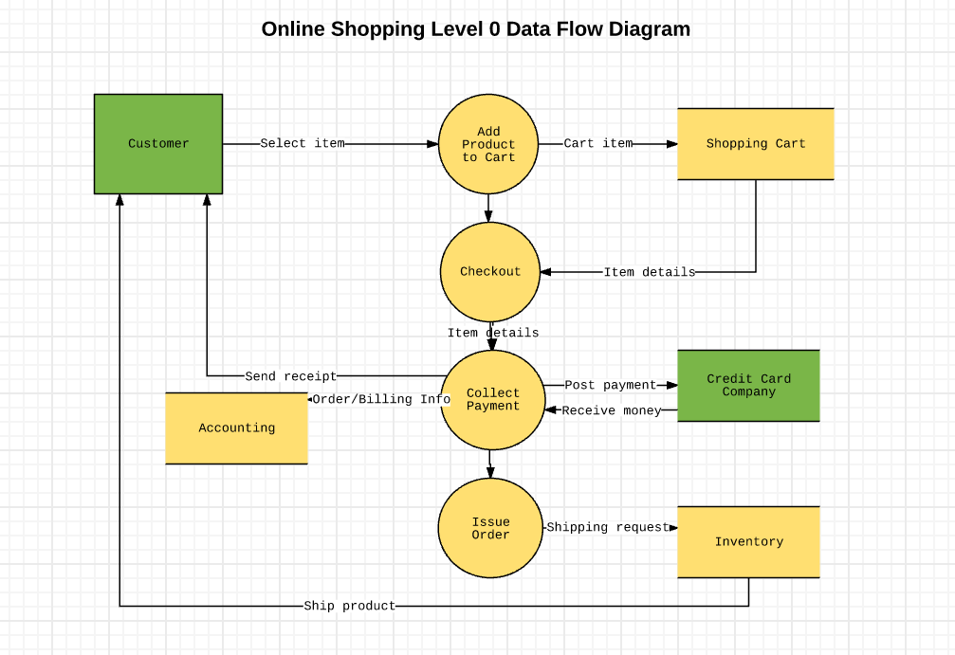
Data flow diagram

Slide 9
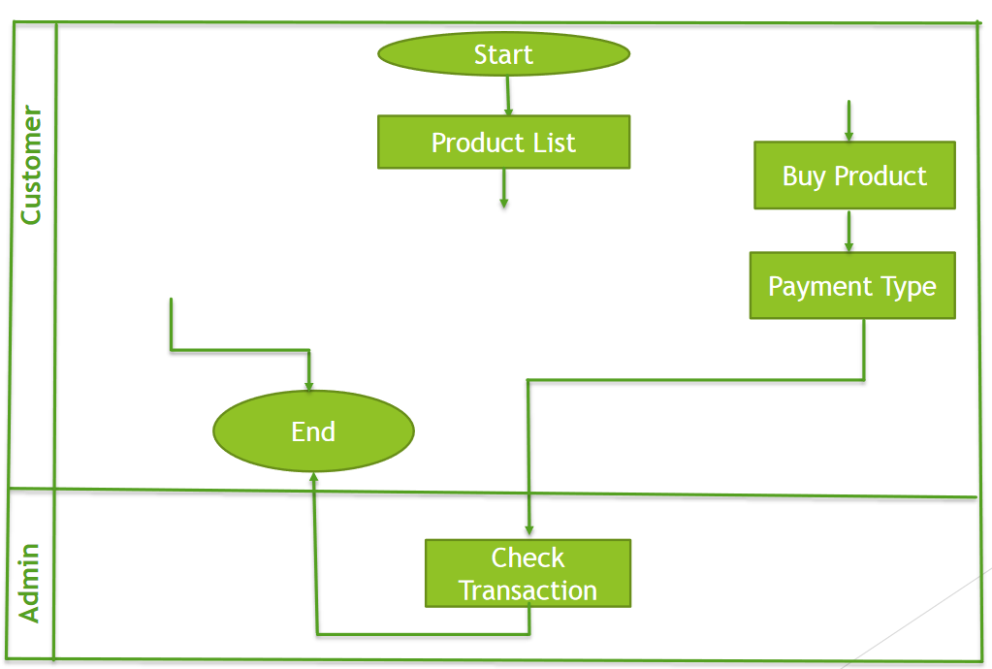
Business process model

Slide 10
ADVANTAGES OF E-COMMERCE
Faster buying/selling procedure, as well as easy to find products.
Buying/selling 24/7.
More reach to customers, there is no theoretical geographic limitations.
Low operational costs and better quality of services.
No need of physical company set-ups.
Easy to start and manage a business

Slide 11
Future plan:-
We are thinking of some modifications and adding some advanced new features in our system. Some of them are—
#GUI modification (more user friendly)
# Users can sell their products
# Users can signup / login using their social media
such as facebook, google+ etc

Slide 12
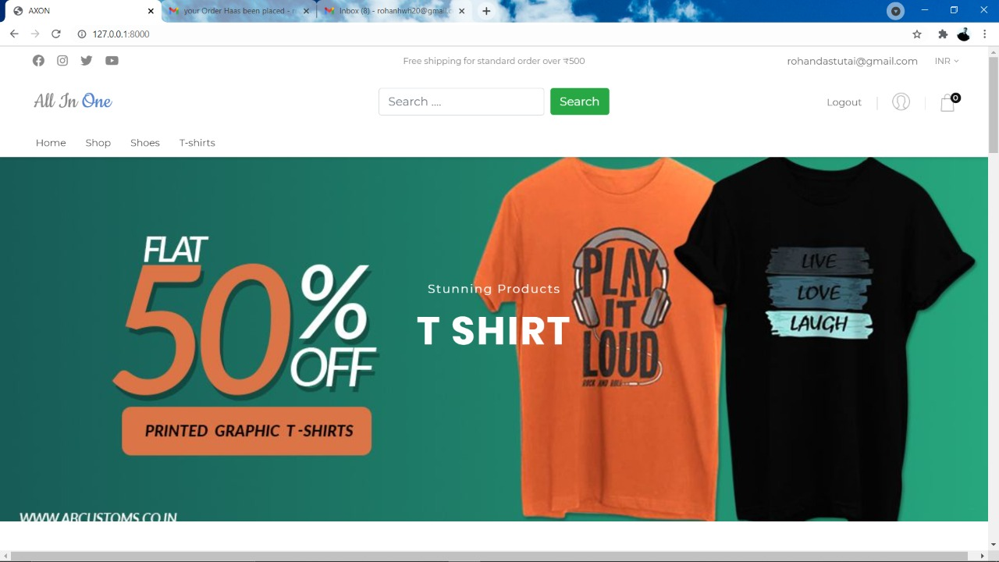
Home page (ALL IN one)

Slide 13
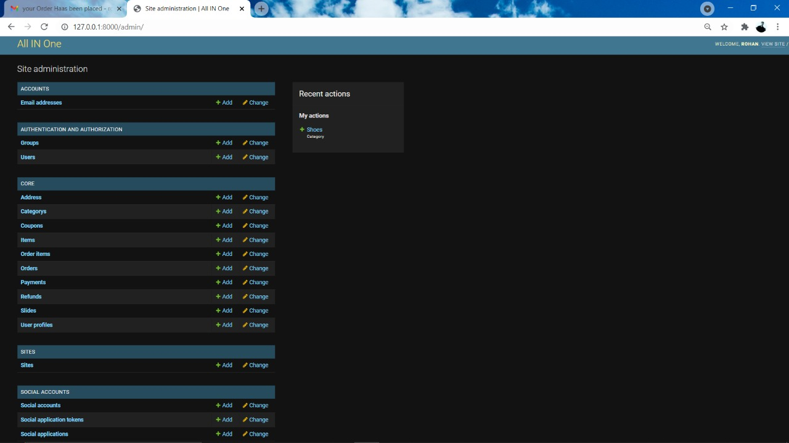
Admin pannel

Slide 14
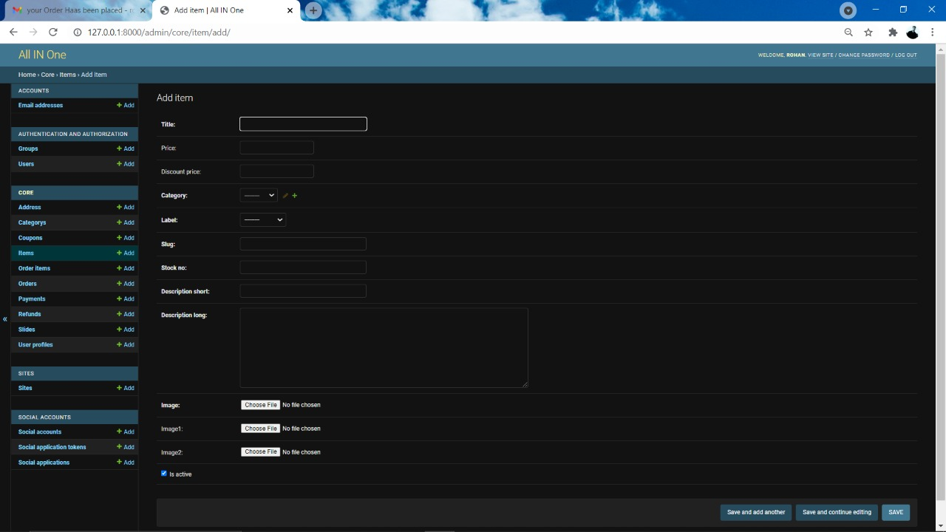
Insert product page

Slide 15
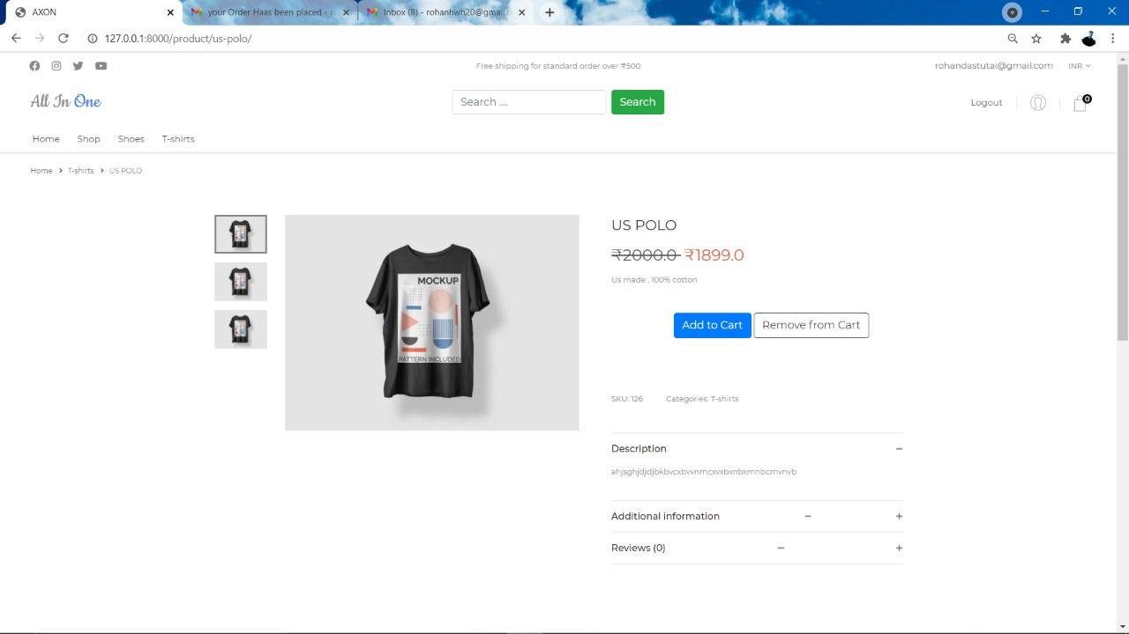
Single product page
“Single product page is for product description and information, from here customer can able to add his item to cart for purchasing.... ,, here we can add different view of product on left image review of blocks for customer visibility.

Slide 16
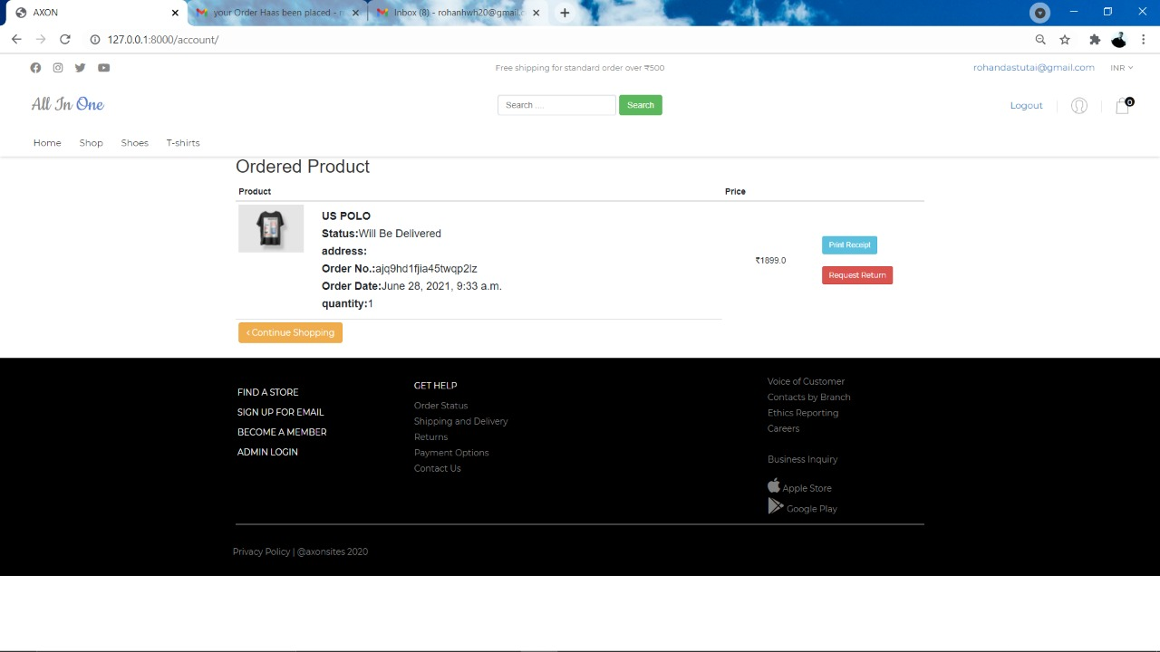
Cart page
“In cart page we will be proceeded after the payment done,, also from here we can request return or able to print invoice page

Slide 17
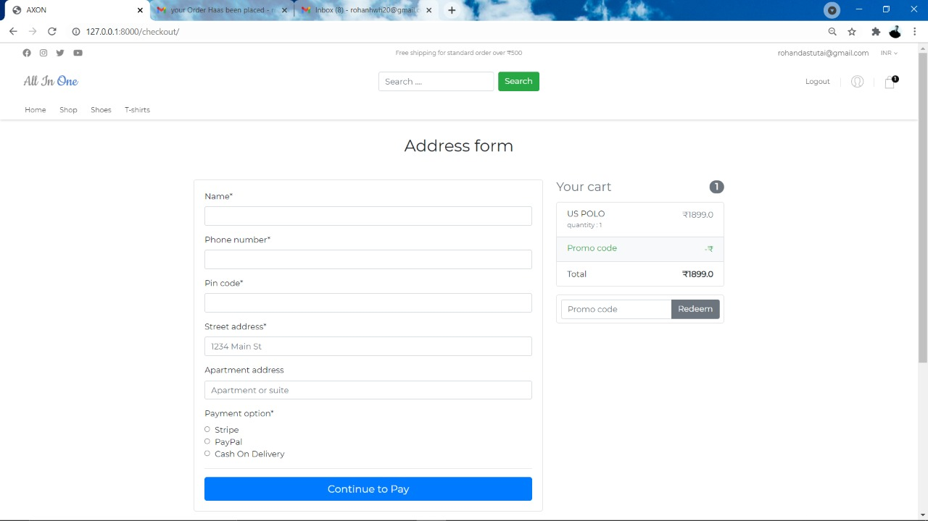
payment page
Here customer information are required to fill ass per the order will be delivered to them with in property times.. Beside it we have option to redeem coupon for discounts and offers on products

Slide 18
Thank You !
Are there any questions ?

